Slide 1

Handwritten Character Recognition
Under the esteemed supervision of :
Prof. Rabindra Kumar Dalei

Slide 2
Prepared by:
Shubham Gantayat
Sujan Kumar Patro
Rajat Pati
Ayush Mohanty
Dibyajyoti Das

Slide 3
Abstract
The handwritten character recognition application focuses on classifying different English alphabets based on their handwritten images.
Main goal areas include OCR(Object Character Recognition) .

Slide 4
What is Handwritten recognition?
Handwritten recognition is a technique or ability of a computer to receive an interpret intelligible handwritten input from source such as paper document, touch screen, photograph etc.

Slide 5
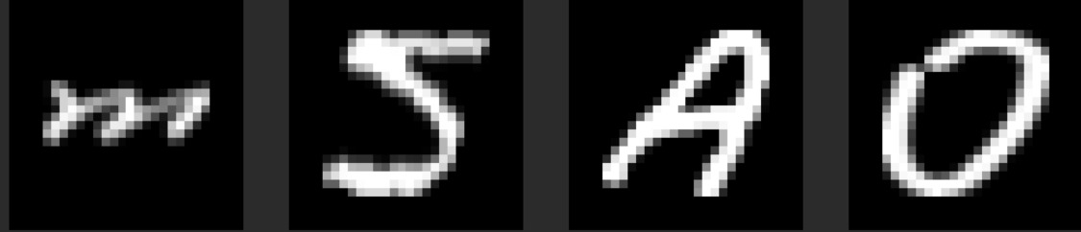
Examples of Handwritten Images:

Slide 6
Preprocessing Methods:
Stratified Random Split: Provides train/test indices to split data in train/test sets. This cross-validation object is a merge of StratifiedKFold and ShuffleSplit, which returns stratified randomized folds. The folds are made by preserving the percentage of samples for each class.
Standard Scaler: Standardize features by removing the mean and scaling to unit variance.

Slide 7
Models used:
Logistic Regression: Logistic regression is a process of modeling the probability of a discrete outcome given an input variable.
Random Forest Classifier: Random Forest is a classifier that contains several decision trees on various subsets of the given dataset and takes the average to improve the predictive accuracy of that dataset. Performance was better in Random Forest for our use case.

Slide 8
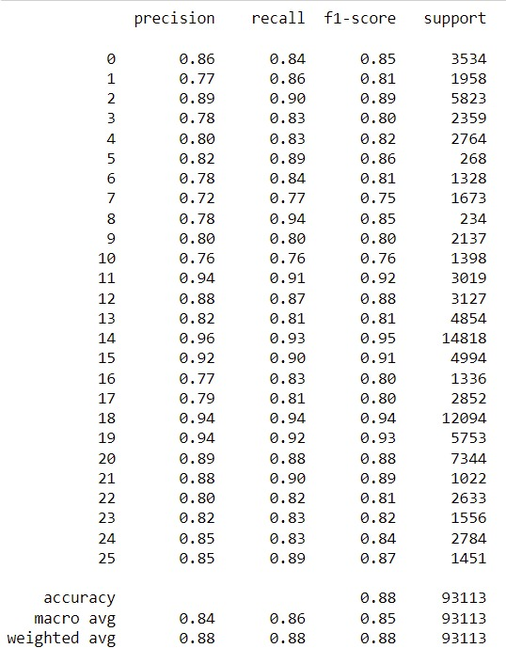
Logistic Regression performance:

Slide 9
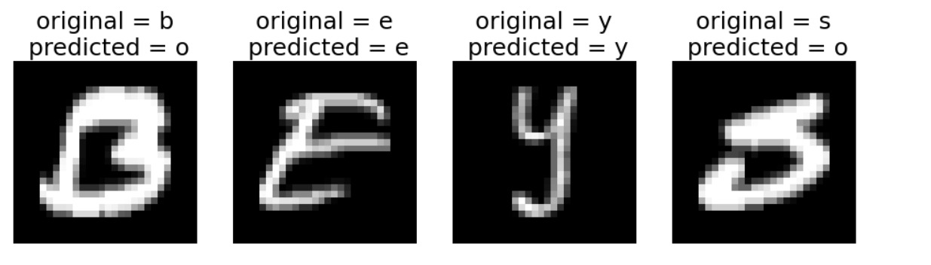
Output of Logistic Regression:

Slide 10
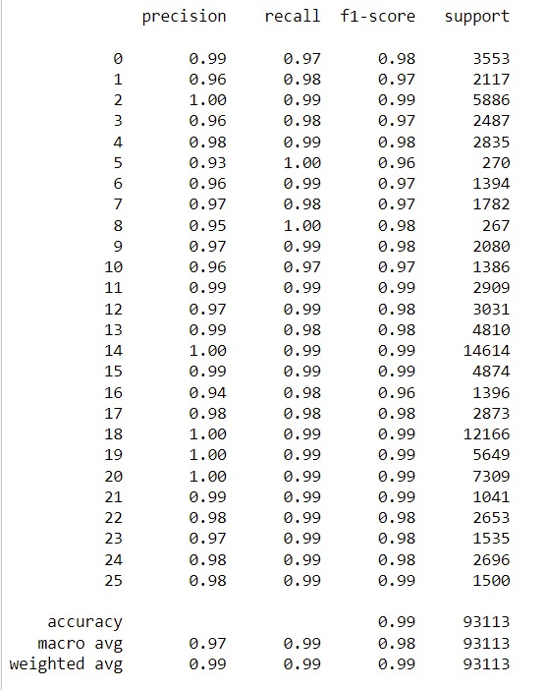
Random Forest Performance

Slide 11
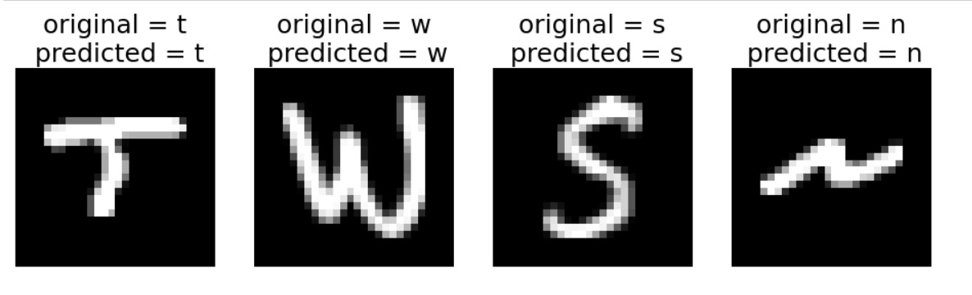
Output images by Random Forest Classifier:

Slide 12
Conclusion:
As Random Forest Classifier (accuracy = 98.6%) performs better than the Logistic Regression Classifier (accuracy = 87.9%) on test data set, we can conclude that it is more suitable for our use case.

Slide 13
Bibliography:
www.kaggle.com/sachinpatel21/az-handwritten-alphabets-in-csv-format/
www.scikit-learn.org/

Slide 14
Thank You

